Slide 1
Inner Circle
Team 1 : Wasupol, Peter, Ananya, Michael, Raef, Jian
MET CS 673 Professor Yuting Zhang

Slide 2

Project Overview
With so many social media and applications,
We still long for intimacy, privacy, and communication with our inner circles such as our close friends and loved ones.
We share our readings, music, opinions, and daily stories freely, We feel the same feel of our close ones, we feel that we are connected.
Here, we are a concrete person instead of a mixture of tags, titles, or fancy pictures.
Target audience: high school and college students, urban youth, and young professionals...

Slide 3
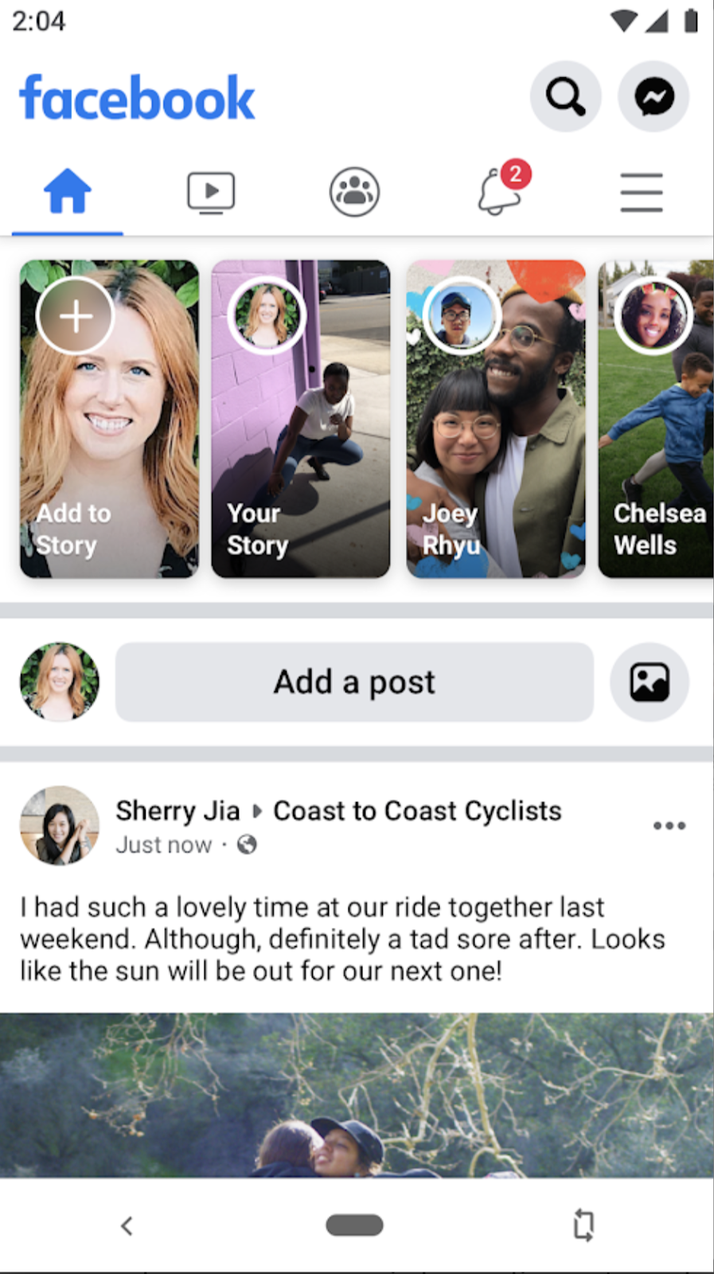
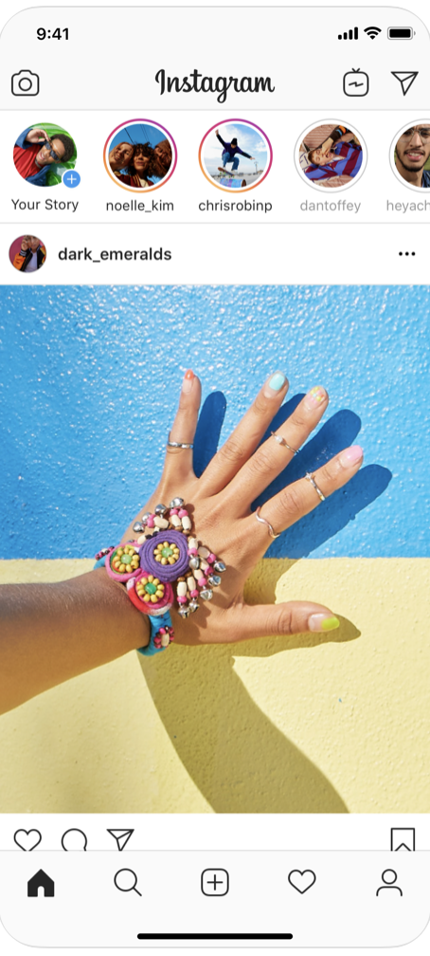
Related Work - Facebook & Instagram
Similarities
Connections from reality.
post updates
Comment under a post.
Chat with their friends
Similarities
Chat with friends
Post updates with pictures or videos.
Comment under a post.
Differences
Weak connected VS
Strong connected
Socializing with the public VS
Social interaction with close ones.
Differences
The tone of InnerCircle
InnerCircle is always online

Slide 4
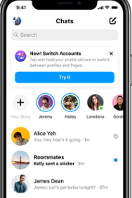
Related Work - Messenger & Whatsapp
Similarities
Connections most from their real life.
Real time chat with their friends.
Video calls and audio calls.
Group chat with their friends.
Differences
Users can share their feelings, opinions, daily stories, videos, etc. in the Broadcast block.
Users are always online.
Video screen sharing

Slide 5




Essential Features
Authentication
Individual Messages
Group Chat

Slide 6




Desirable Features
File Sharing
Video Calls
Voice Memos

Slide 7



Optional Features
Emojis and Stickers
Screen Sharing

Slide 8
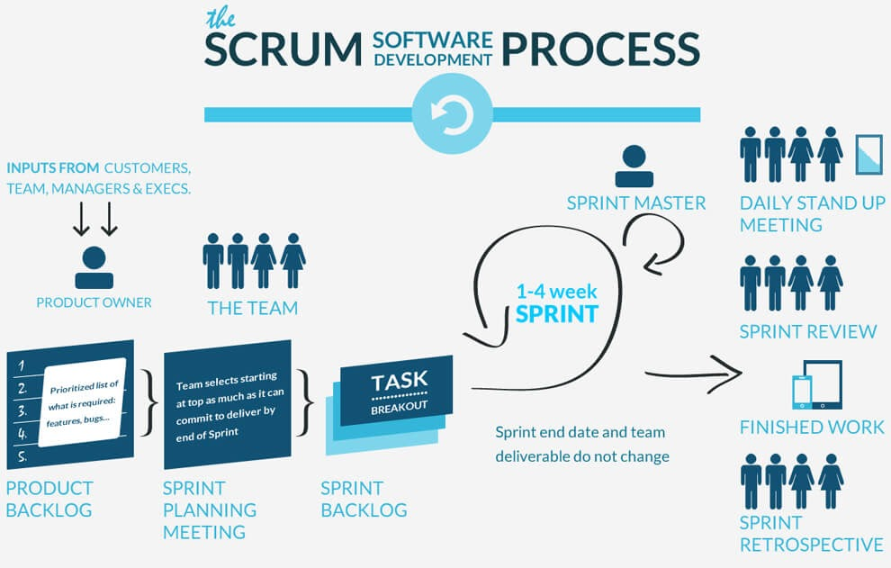
Process Model

Slide 9
Process Model
Just short updates. (2-3 days update)
3 Weeks

Slide 10
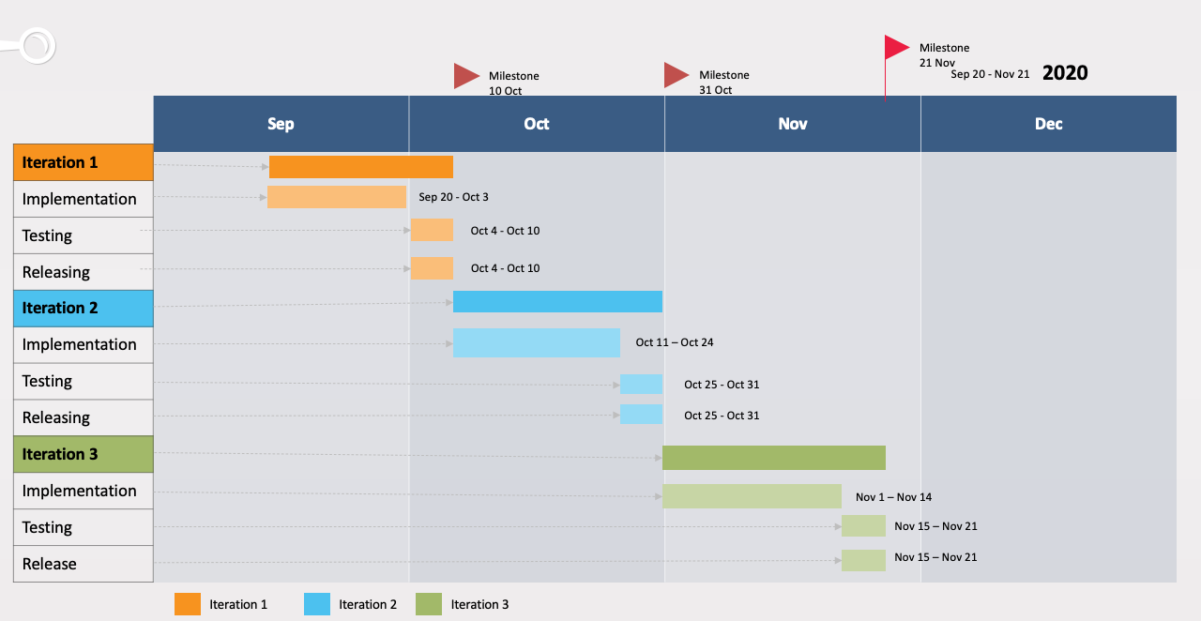
Project Timeline

Slide 11














Implementation Plan

Slide 12
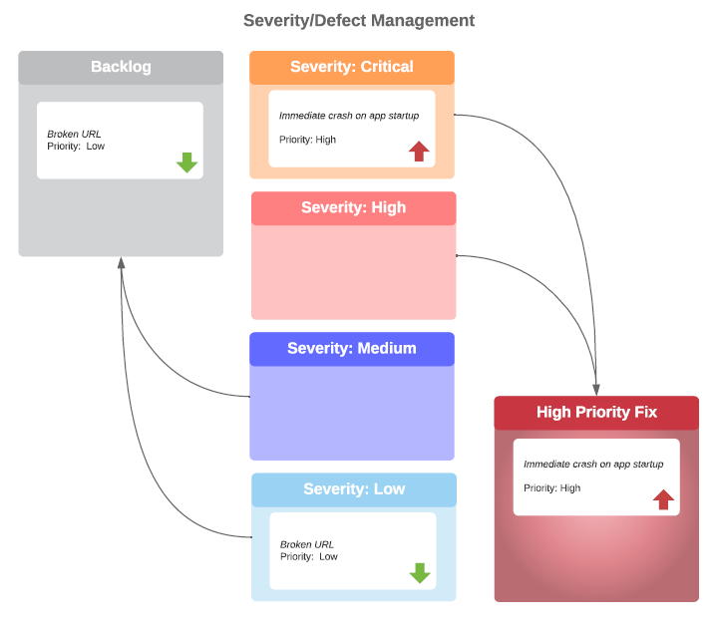
Quality Assurance Plan
Management Tool: Pivotaltracker
Product Metrics:
Defects per lines of code
# failed chat applications per given # of reference chat applications.

Slide 13

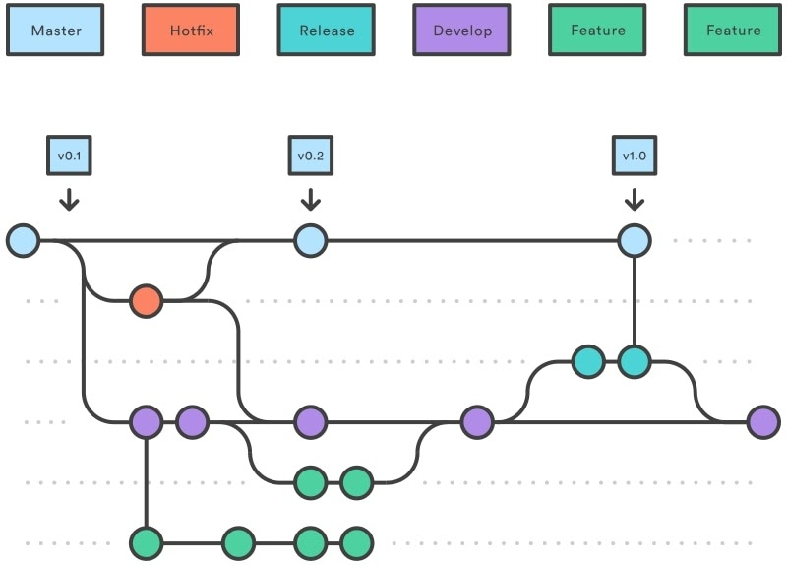
Configuration and Management Plan
Requires 1 reviewer in GitHub

Slide 14




Security
Development
Connection

Slide 15
Thank You
Questions ?

